Slide 1
Travelling Salesman Problem: Convergence Properties of Optimization Algorithms
Group 2
Zachary Estrada
Chandini Jain
Jonathan Lai

Slide 2
Introduction
B
F
A
C
E
D
Travelling Salesman Problem
Surface Reconstruction
Marcus Peinado and Thomas Lengauer. `go with the winners' generators with applications to molecular modeling. RANDOM, pages 135{149, 1997.

Slide 3
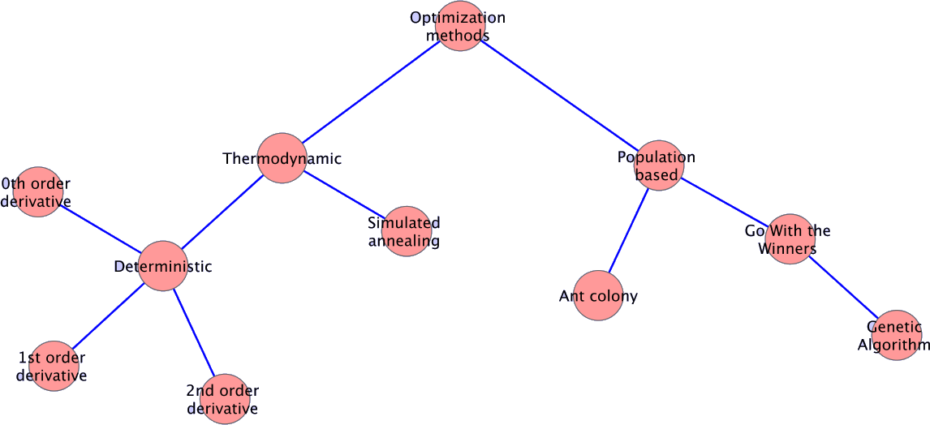
Hierarchy of Optimization Methods

Slide 4
Hamiltonian Description
Penalizes vertices with connections unequal to required connection
Where,
r_{i} is the position of particle_{i}
V_{k} is the number of vertices particle_{i} is connected to
V₀ is the actual number of vertices particle_{i} should be connected to
k_{b} = 1, bond constant
k_{v} = 1024, vertex constant

Slide 5
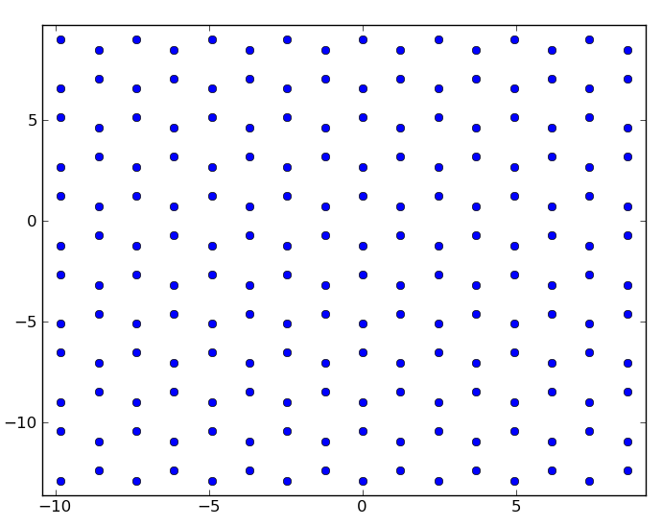
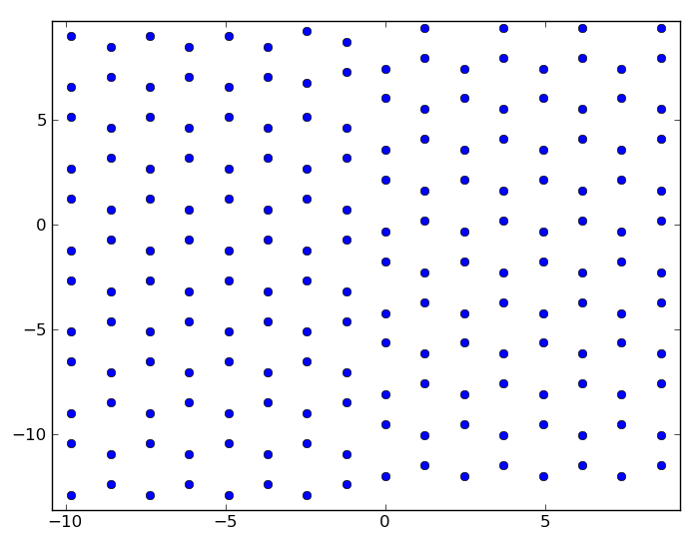
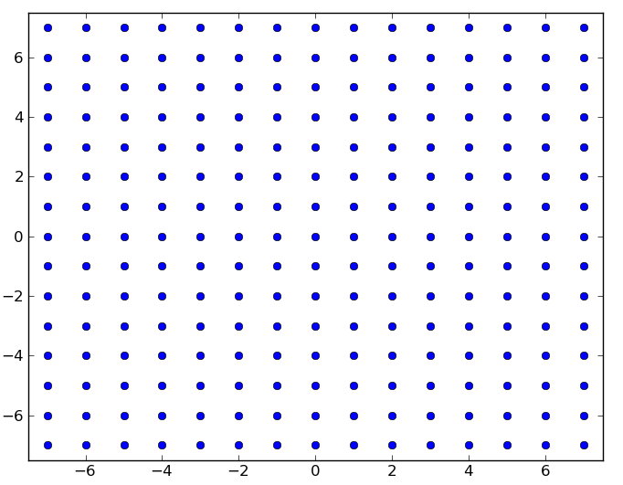
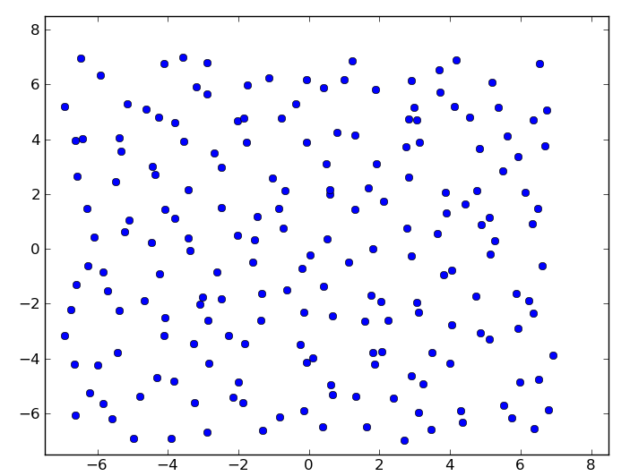
Test Systems
Honeycomb Lattice
Sheared
Honeycomb Lattice
Square Lattice
Square Lattice –
Random Positions

Slide 6
Code Implementation
Java – Heavylifting
Software Java 1.6
Python – Analysis
Tcl – Analysis

Slide 7
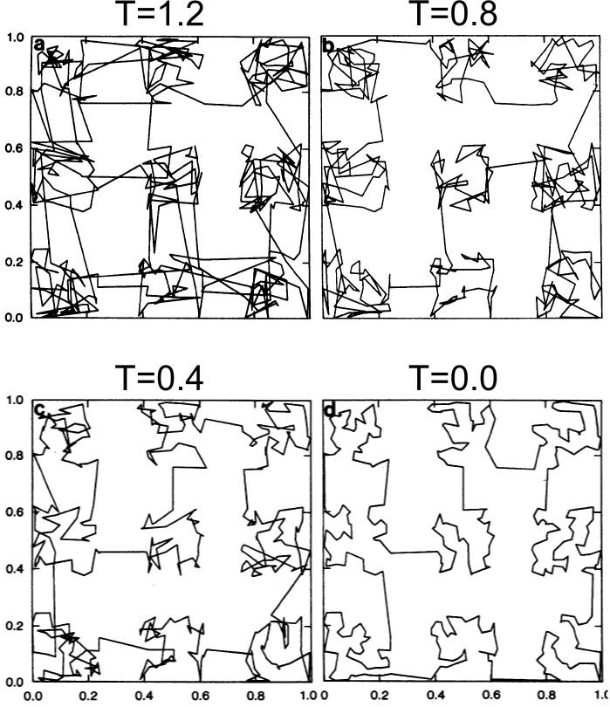
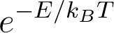
Simulated Annealing: Controlled Cooling
"Optimization by Simulated Annealing" S. Kirkpatrick, C. D. Gelatt, Jr., and M. P. Vecchi, Science 13 May 1983: 220 (4598), 671-680.

Slide 8

Simulated Annealing Moves
http://mathbits.com/mathbits/studentresources/graphpaper/graphpaper.htm

Slide 9
Simulated Annealing Moves
http://mathbits.com/mathbits/studentresources/graphpaper/graphpaper.htm

Slide 10
Simulated Annealing Moves
http://mathbits.com/mathbits/studentresources/graphpaper/graphpaper.htm

Slide 11
Simulated Annealing Moves
http://mathbits.com/mathbits/studentresources/graphpaper/graphpaper.htm

Slide 12
Ant Colony
Couple of Slides

Slide 13
Genetic Algorithms: Survival of the Fittest
Generate an initial random population
1 | 1 | 0 | 1 | 1
1 | 0 | 0 | 0 | 1
0 | 1 | 0 | 0 | 1
0 | 1 | 1 | 1 | 0
Evaluate fitness of individuals
Select parents for crossover based on fitness
Introduce children into the population and replace individuals with least fitness
1 | 1 | 0 | 1 | 1
1 | 0 | 0 | 0 | 1
Perform crossover to produce children
1 | 1 | 0 | 0 | 1
1 | 0 | 0 | 1 | 1
1 | 0 | 1 | 1 | 1
Mutate randomly selected children
“A genetic algorithm tutorial”, Darrell Whitley , Statistics and Computing, Volume 4, Number 2, 65-85, DOI: 10.1007/BF00175354

Slide 14
Genetic Algorithm: Generation Rules
Selection - Fitness proportionate/roulette-wheel selection:
Area of the wheel assigned to each parent in proportion to fitness
Crossover - Matrix Crossover Variant:
Select a column M at random and interchange column data between parents
After interchange, V_{k}> V₀ for any particle, disconnect from farthest neighbor
Mutation - 2-Opt Operator Variant:
Connect all particles between two randomly chosen points i₁ and i₂ with a randomly chosen neighbor
After interchange, V_{k}> V₀ for any particle, disconnect from farthest neighbor

Slide 15
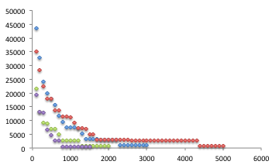
Genetic Algorithm: Energy v/s Iterations
Hexagonal Lattice

Slide 16
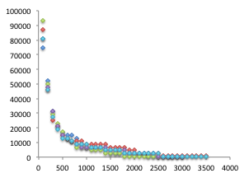
Genetic Algorithm: Energy v/s Iterations
Sheared Hexagonal Lattice

Slide 17
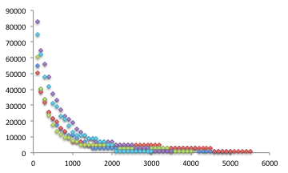
Genetic Algorithm: Energy v/s Iterations
Square Lattice – Random Positions

Slide 18
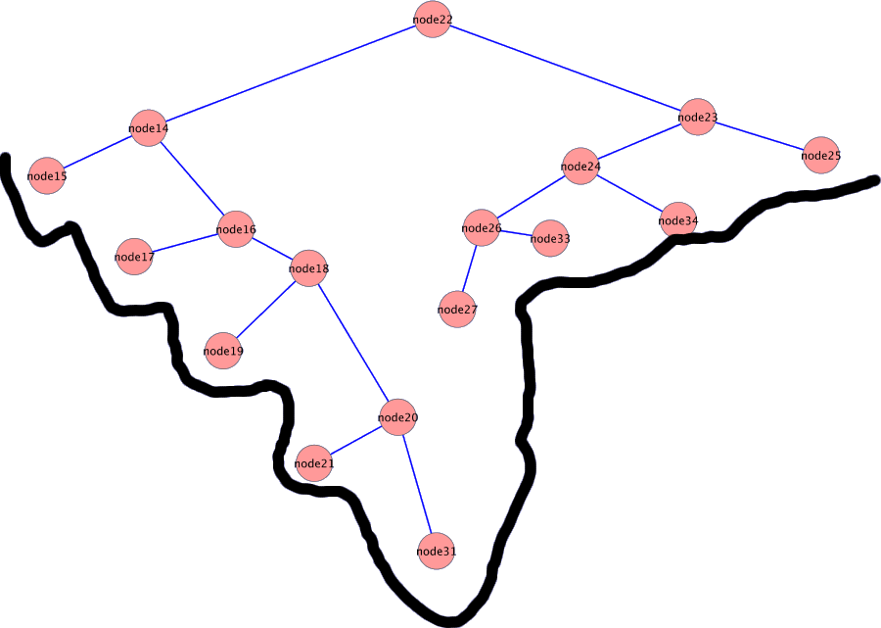
Go With The Winners

Slide 19
Go With The Winner
GWTW – Simulated Annealing with survival of fittest
Moves are predetermined
Create/destroy bonds
Swap bonds to explore phase space faster
Survival of the fittest
Select single winner of system
Kill off lower half of population
Repopulate single winner clone

Slide 20
Honeycomb Lattice: Comparison
Best Solutions
All Algorithms
 | Simulated Annealing | Ant Colony Optimization | Genetic Algorithm | Go With the Winner
Avg Energy | 535.967999 | 535.967999 | 703.6449 | 535.967999
Best Energy | 535.967999 | 535.967999 | 535.967999 | 535.967999
Avg Run Time (s) | 797 | 9 | 113 | 1422
Avg Iterations | 800000 | 94 | 2800 | 400000

Slide 21
Square Lattice: Comparison
Best Solutions
Simulated Annealing
Other Algorithms
 | Simulated Annealing | Ant Colony Optimization | Genetic Algorithm | Go With the Winner
Avg Energy | 1277 | 450 | 450 | 1518
Best Energy | 1277 | 450 | 450 | 450
Avg Run Time (s) | 1093 | 24 | 113 | 1713
Avg Iterations | 800000 | 128 | 2800 | 400000

Slide 22
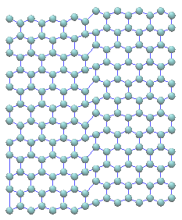
Sheared Hexagonal Lattice: Comparison
Best Solutions
Ant Colony Optimization
Genetic Algorithm
Go With the Winner
 | Ant Colony Optimization | Genetic Algorithm | Go With the Winner
Avg Energy | 554.928 | 606.89764 | 962.64
Best Energy | 554.928 | 554.928 | 962.64
Avg Run Time (s) | 4 | 155 | 940
Avg Iterations | 243 | 3100 | 400000

Slide 23
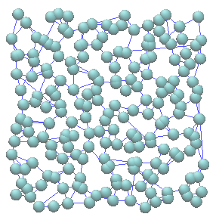
Square Lattice-Random Positions: Comparison
Best Solutions
Simulated Annealing
Ant Colony Optimization
Genetic Algorithm
Go With the Winner
 | Simulated Annealing | Ant Colony Optimization | Genetic Algorithm | Go With the Winner
Avg Energy | 2999.99 | 463.1 | 672.762708 | 2708.94068
Best Energy | 2999.99 | 463.1 | 612.181165 | 2571.18136
Avg Run Time (s) | 821 | 715 | 187 | 1435
Avg Iterations | 800000 | 5101 | 4200 | 400000

Slide 24
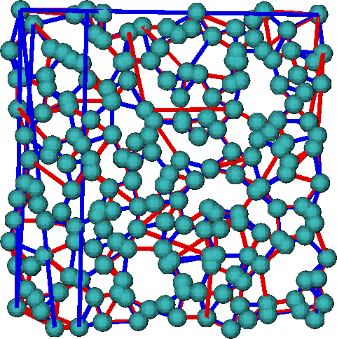
Comparison Between Solutions
Square Lattice - Random Positions
ACO
GA
Connections
634 similar
270 unique
138 : 132 Left v/s Right

Slide 25
Conclusion
ACO ~ GA >> GWTW > SA
Choice of move is essential for efficient computation
Must highly tune code to run

